Slide 1
Group Project - Analytics

Slide 2
Problem Statement
Nitin works as a Graphic Designer in a new company. He earns Rs 15,000/- per month. He is planning to buy a scooter for his daily commute to the office.
For the last couple of months, Nitin is not able to save at all for his scooter. His friend Ayush told him that he needed to figure out where most of the money goes and cut down that expense.
Help Nitin increase his savings by removing some unnecessary expenses.

Slide 3
Part 1

Slide 4
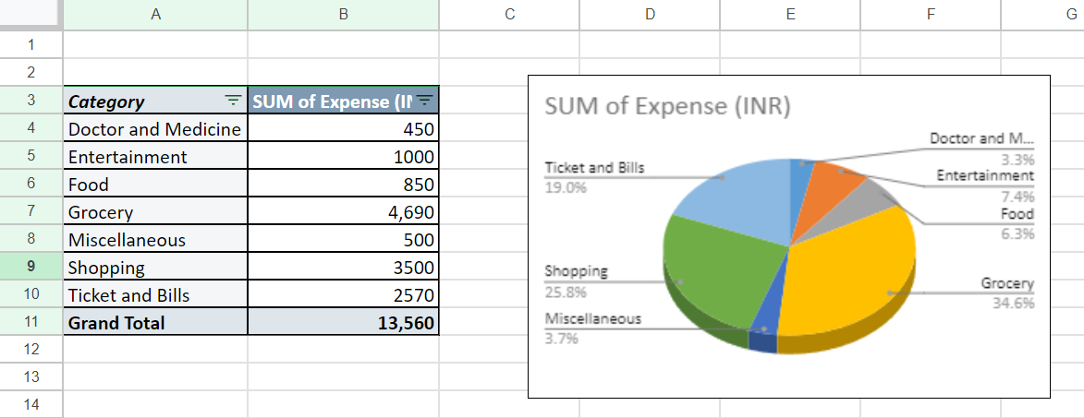
Part 1- Task 1
How much is spent for each category (Pivot Table)
Visually represent the amount spent against each category is what percentage of the total expense amount (Pivot Chart)

Slide 5
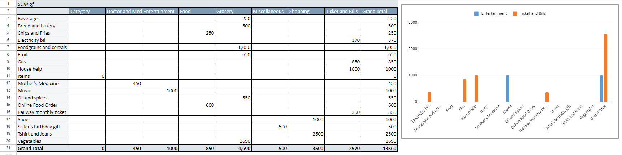
Part 1- Task 2
How much is spent on different items of each category (Pivot Table)
Visually represent the amount spent on different items of Entertainment and Tickets and bills category (Pivot Chart)

Slide 6
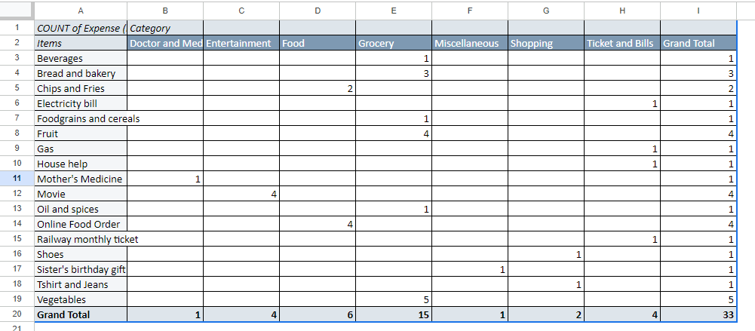
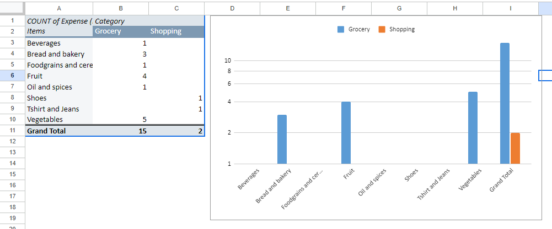
Part 1- Task 3
How many times money has been spent against different items of each category (Pivot Table)
Filter the data to display the data for Grocery items and Shopping items

Slide 7
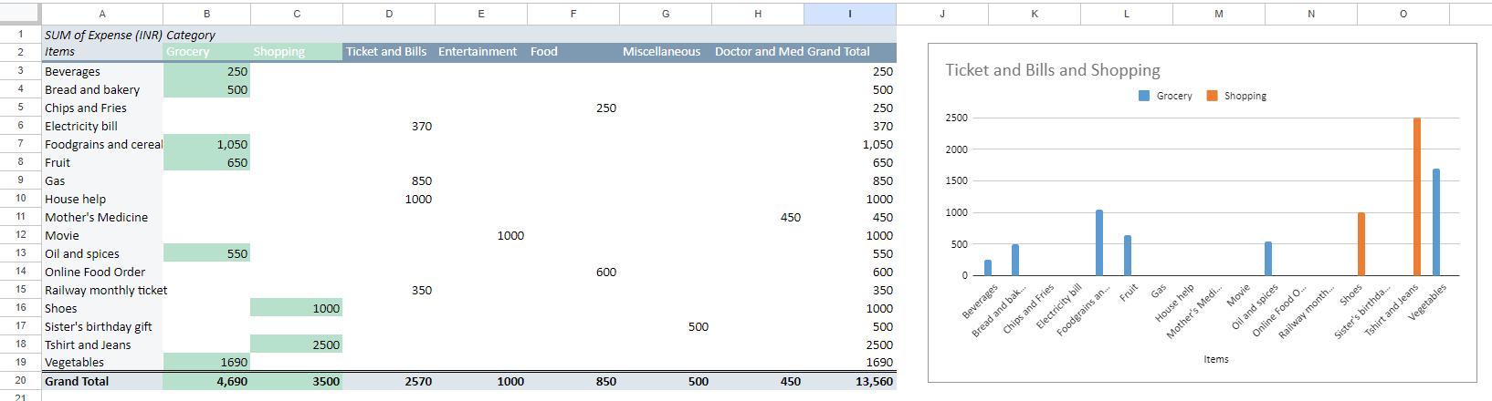
Part 1- Task 4
What amount is spent on each item of the categories with highest and 2nd highest expense amount (Pivot Table)
Visually represent the data with data bars (Conditional formatting)

Slide 8
Analysis Part 1
Queries | Solution
The category with the highest expense amount | Grocery (Depicted in Part-1 Task-1)
Total expense amount against entertainment and shopping | Entertainment – Rs. 1000/- Shopping – Rs. 3500/- (Depicted in Part-1 Task-2)
Number of times Nitin has ordered food online and the amount spent for it | Count – 4 times Amount spent – Rs. 600/- (Depicted in Part-1 Task-2 & 3)
Number of times Nitin has watched a movie | Count – 4 times (Depicted in Part-1 Task-3)
The less essential category that Nitin may remove to increase his savings | Entertainment – as we observe 7.4% of entire expense is being spent less essential category, by removing which the saving could be increased.

Slide 9
Part 2

Slide 10
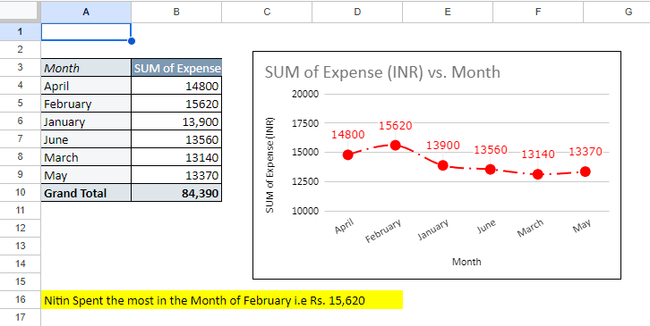
Part 2- Task 1
Month-wise trend of expenses (Pivot table and chart)
Find out the month Nitin spent the most

Slide 11
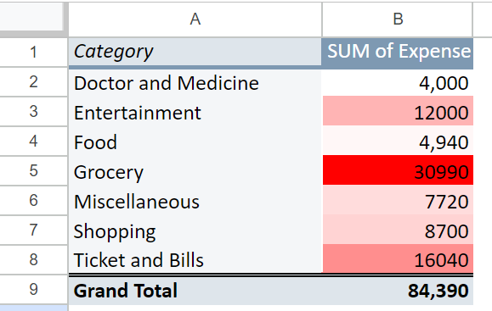
Part 2- Task 2
Category wise expenses (Pivot table)
Visually represent it with data bars to display categories with the highest and lowest expense amount

Slide 12
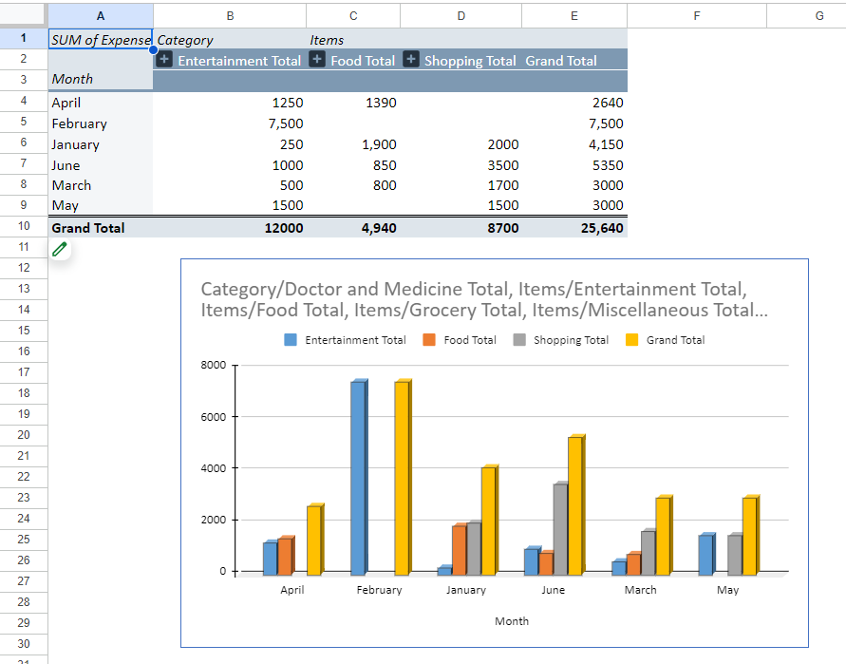
Part 2- Task 3
Month-wise expense of each category (Pivot table)
Find out 2 categories with higher expenses for each of the 6 months

Slide 13
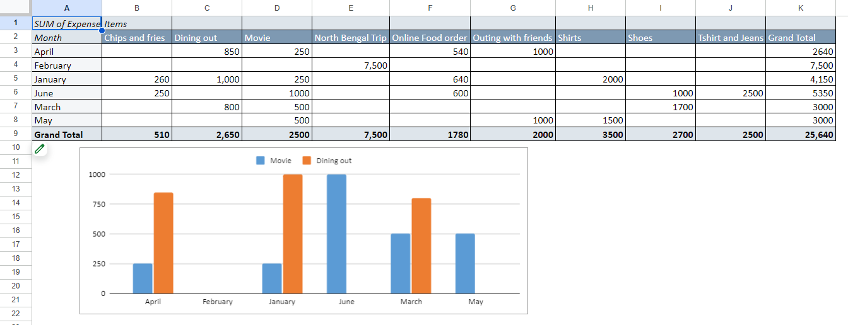
Part 2- Task 4
How much is spent in each month against different items of Entertainment, Food and Shopping categories (Pivot table)
Find out which months have the highest amount spent for movies and dining out

Slide 14
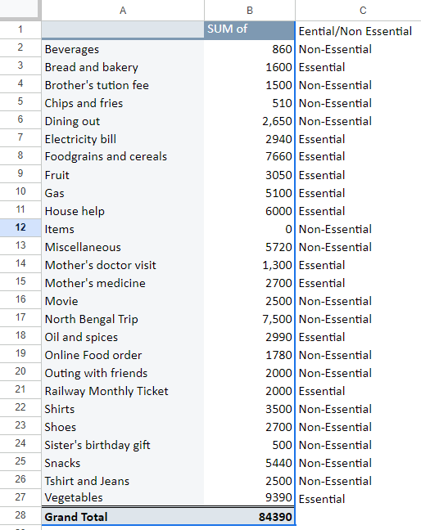
Part 2- Task 5
Decide on the essential and less essential items and analyse the expenses
Recommend how can Nitin increase his savings
In order to increase saving, Nitin should control/restrict the non-essential items as depicted.

Slide 15
Analysis Part 2
Queries | Solution
The month-wise trend of expenses and find out the month Nitin spent the most | Nitin Spent the most in month of February i.e Rs. 15,620/ (Depicted in Part-2 Task-1)
Visual representation of expenses against different categories | (Depicted in Part-2 Task-2)
Top 2 categories with higher expenses for each month | January :-Grocery and Ticket & Bills February :-Entertainment and Grocery March :-Grocery and Ticket & Bills April :-Grocery and Miscellaneous May :-Grocery and Ticket & Bills June :-Grocery and Shopping (Depicted in Part-2 Task-3)
Recommendations on how can Nitin increase his savings | Nitin can reduce the spend on Entertainment category , also online ordering of food which will help him increase his savings

Slide 16
Thank you

